Slide 1


Town and Parish Councils
parishcouncils@lancashire.gov.uk

Slide 2
Purpose of todays briefing
Provide an overview for county councillors
Clarify roles, responsibilities and expectations
Highlight current activity, challenges and opportunities

Slide 3
The Team
Place Executive Directorate
Communities and Engagement Directorate
Civic Pride and Safety Service
Community Safety Team
Town and Parish Council Team
Notes:
Our role​
Act as the central coordination point for parish and town councils​
Support effective relationships between LCC services and local councils​
Ensure consistent, equitable engagement across the county​
What we do​
Single point of contact via dedicated mailbox​
Manage and triage queries​
Coordinate consultations​
Maintain key relationships and information flows​
Deliver engagement, briefings and events

Slide 4
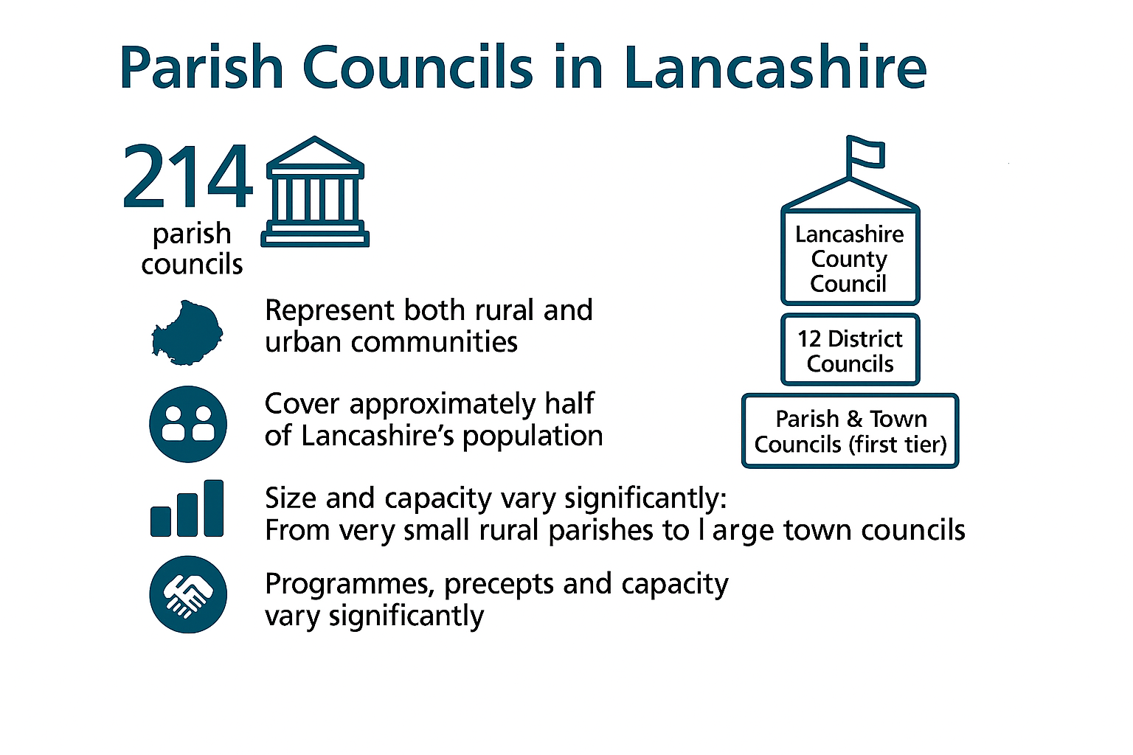
Notes:
ADDITIONAL RESOURCE – PARISH BOUNDARY MAP
There are approximately 195 parish councils and 19 town councils in Lancashire 12 (LCC patch) of very different sizes. Work is ongoing to reach a definitive number. Only around half of Lancashire’s population currently lives in a parished area – the rest are in unparished communities. Parish and town councils represent both rural and urban areas, from very small rural parishes to large town councils with significant budgets and capacity. This diversity means one size does not fit all when working with them. As democratically accountable bodies, they provide a way to shape local decisions, decentralise services, and help revitalise local communities. The structure diagram helps reinforce that they are the first tier, sitting beneath districts and alongside the county council as part of a wider system.
Unparished areas
Lancaster Central Lancaster, Heysham, Fylde, Thornton Cleveleys and Poulton le Fylde, Lytham, Preston, Central Preston, South Ribble Bamber Bridge, Leyland, Chorley, Central Chorley, West Lancs, Ormskirk, Skelmersdale, Burnley, Central Burnley, Hyndburn Great Harwood, Rishton, Accrington, Oswaldthwistle, Rossendale, Haslingden, Bacup.
Implications for residents if their area is unparished
Residents of unparished areas may face several implications, including the lack of a dedicated local council to manage their interests and services. This can lead to a reduced level of local governance and control over community affairs. Unparished areas may also have fewer opportunities for community engagement and involvement in local decisionmaking processes. Additionally, residents may experience a lack of uniformity in service delivery and governance standards compared to parished areas.

Slide 5
Why it matters to LCC
1st tier of government
Closest to communities
Democratically elected and statutory
Represent local priorities and insight
Key delivery and engagement partners
Notes:
Parish and town councils are the first tier of government, with a statutory role and democratic mandate. They are closest to residents and often see emerging issues before they reach district or county level. They bring local intelligence, insight and challenge that helps LCC design better services. They represent place‑based priorities, not single services. Strong relationships reduce duplication, improve consultation, and prevent escalation of issues. Effective engagement supports LCC’s wider ambitions around prevention, early intervention and community resilience.

Slide 6
Engagement
Listen
Charter
Share
Partners
Connect
Respect
Notes:
Listen Early: Build relationships before there is a problem. Share information: Use parish councils as a two‑way channel: sharing LCC priorities while gathering local intelligence. Treat them as partners: Involve them early in consultation and change, not after decisions are made – clerks are all part time so we need to give 4-6 week lead in time for any consultation, to allow the clerks chance to share the information with councillors and/or residents. Connect them in: Where appropriate, link them to officers, neighbourhood teams or funding opportunities. Respect their role: Be clear about roles: parish councils are partners, not delivery agents by default. Good engagement saves time later and strengthens LCC’s credibility locally.
Charter: These points are covered in the charter
Acknowledge charter is out of date but that parishes still refer to it. Endorsed at the Parish & Town Council Conference (Nov 2024) It has been referred to as best practice by NALC but more recently highlighted as needing refreshing. Work currently ongoing in partnership with working group to refresh the charter and relaunch at the parish conference. What it covers
Communication and information sharing
Consultation principles
Access to services and contacts
What it is not
Not a service‑level agreement
Not a performance framework

Slide 7



Key contacts
Notes:
Since 1947, the National Association of Local Councils (NALC) has been England's only recognised national membership organisation for community, neighbourhood, parish and town councils. We work with county associations to support, promote, improve and create sustainable councils.
LALC was formed in 1944 and is an independent organisation representing the interests of Parish & Town Councils in Lancashire, Merseyside, and Greater Manchester. The Lancashire Association also incorporates the Merseyside Association of Parish & Town Councils. The aim of the Association is to offer support to member councils to help them achieve the highest standards of Local Government, to offer training and to represent the first tier of local government as widely as possible. LALC also run area committee meetings, all parishes are welcome and don’t need to be members. The chairs of the ACM’s are key stakeholders with whom we keep regular contact via a working group who meet quarterly with head of civic pride and safety service.
Founded in 1972, SLCC has gone from strength to strength, starting with just 50 members and now representing clerks to over 5,000 local councils in England and Wales.
As the professional body for local council clerks and senior council employees, we ensure that our members are equipped with the necessary knowledge, training and skills to thrive within their role and best support their council and community.

Slide 8

Systems and Processes
Love Clean Streets App
Parish Inbox
Enquiry System
Area Committee Meetings
Local County Councillor
Notes:
ADDITIONAL HANDOUTS – QUERY FLOW CHART
- UPCOMING AREA COMMITTEE MEETINGS
Love Clean Streets – highways enquiries
Parish Inbox – parishcouncils@lancashire.gov.uk - 5 day SLA – current response rate average is 1.1 days
Enquiry system – anything else – governance group currently set up to streamline the system and make it more accessible to parish councils. We will be holding an enquiry system surgery at the conference in November.
Area Committee Meetings – District meetings of parishes, attending by town and parish council team, parish champion and elected members. Officers either answer queries directly, escalate to relevant elected member or advise on how to log query through enquiry system
**Before attending an area committee meeting, please liaise with parishcouncils@lancashire.gov.uk (parish team) and james.tomlinson@lancashire.gov.uk (parish champion) to ensure a coordinated approach**
County Councillor – when queries have not been resolved satisfactorily, clerks and parish councillors are advised to approach their local county councillors (as are residents)

Slide 9


Funding Opportunities
Parish Champion Grants - Champion grants scheme - Lancashire County Council
Sport and Cultural Fund - Crowdfund Lancashire - Lancashire County Council
Idox – Lancashire 4 Community - Home | Lancashire County Council 4 Community

Slide 10
Communication
Regular Newsletter
Parish Database
Annual Town and Parish Conference
Working Group
Notes:
ADDITIONAL RESOURCE – PARISH CONFERENCE EXECUTIVE DEBRIEF
- MOST RECENT NEWSLETTER
Newsletter with key updates sent regularly
Database – outgoing communication, clerks responsible for maintaining own contact details, less risk if clerks move on and no GDPR necessary. We maintain contact with clerks rather than councillors as it is a paid role. Communications have included key policy and strategy updates, road closures, winter bulletin, updates to bus services and sharing of best practice. Need to give 4-6 week lead in time as clerks are part time.
Annual conference 2026 – 14th November 2026 – sold out last 2 years. Conference was well-received by in-person attendees, with high satisfaction scores across most areas. Delegates praised the organisation, venue, and relevance of content, while also highlighting areas for improvement, particularly around diversity of content, stall engagement, and political neutrality. Conference also supports comms with other services i.e. highways, road safety, LVP etc.
Working group – meets quarterly, membership of LALC area committee chairs or nominated deputies, chaired by head of civic pride and safety service. Recent topics include charter refresh, parish conference, enquiry system and access to services.

Slide 11
SWOT Analysis
Shared aims:
Stronger relationships
Clearer communication
Better outcomes for local communities
Notes:
ADDITIONAL HANDOUT – SWOT ANALYSIS

Slide 12
Summary
Town and Parish Councils are critical democratic partners
The Town and Parish Council team provides coordination
The Charter sets the framework – behaviour brings it to life
Cabinet leadership is key to effective relationships
Consistent and meaningful engagement supports services and improves relationships

Slide 13
Any Questions?

